Slide 1
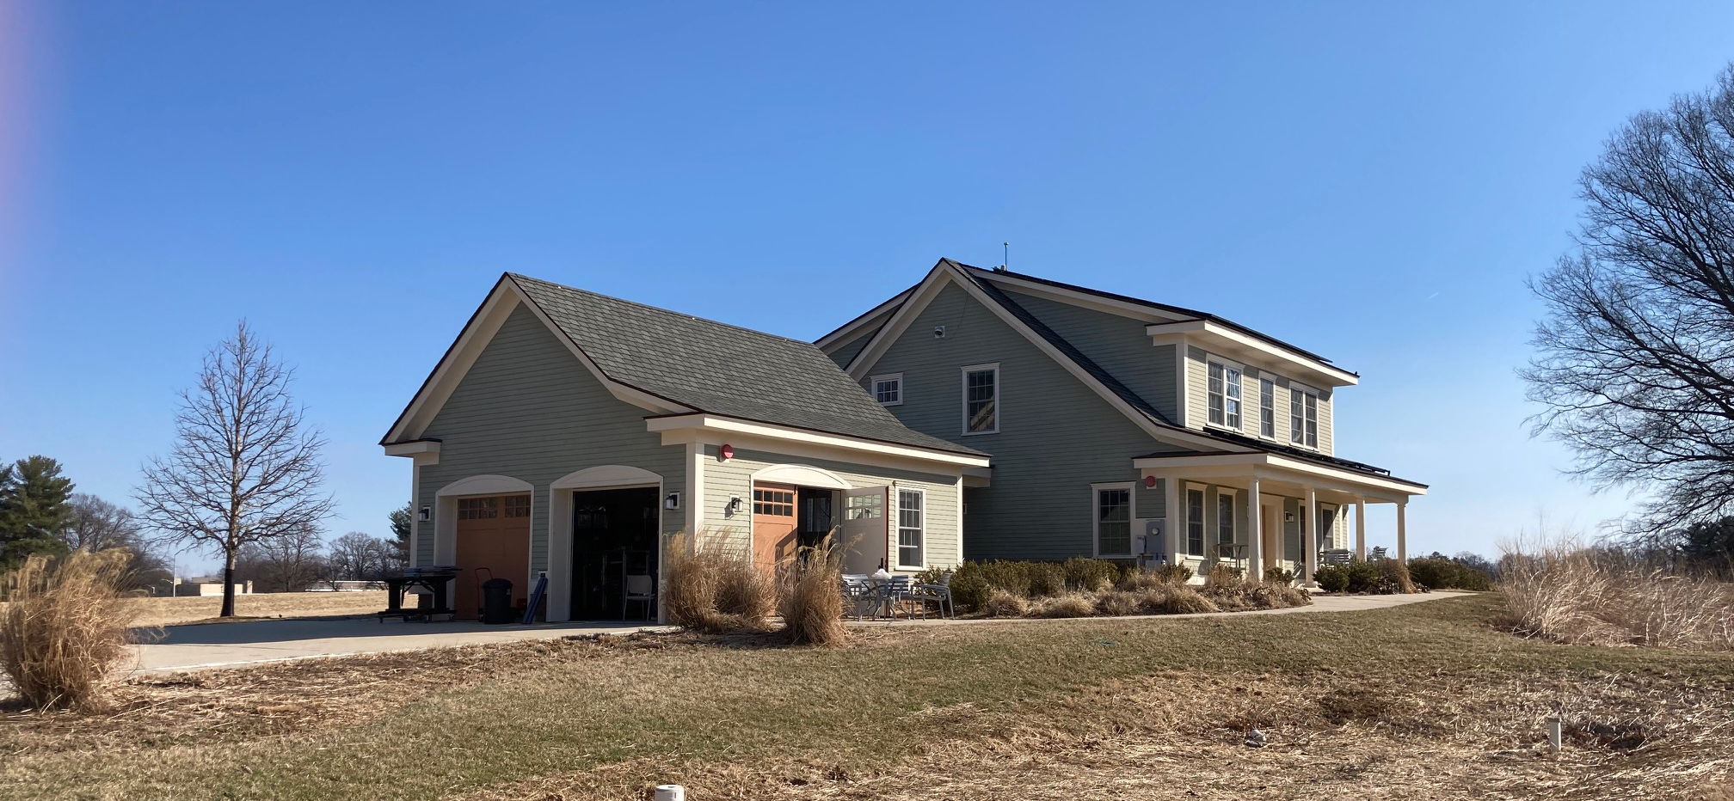
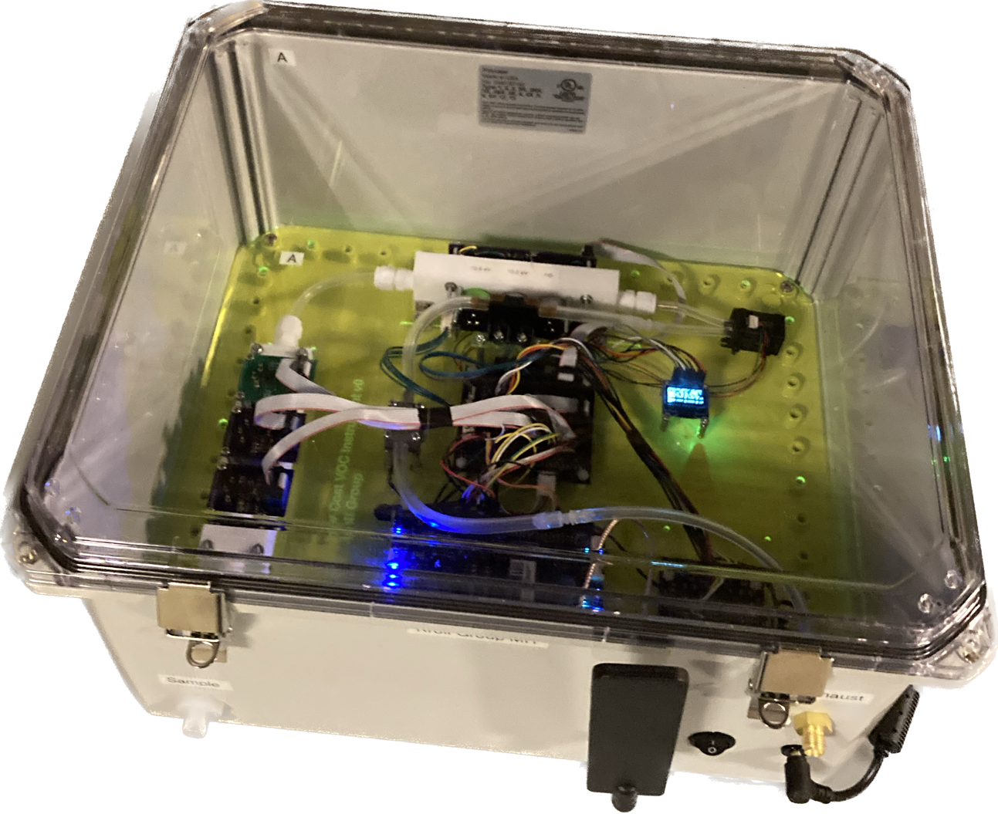

Slide 3

Clean air
O₃
OH
OH
O₃
O₃
Notes:
… we designed a series of experiments to look at ozone production and the impacts on the chemistry of indoor air…
…From these measurements, I’d like to highlight three interesting observations…

